Slide 1
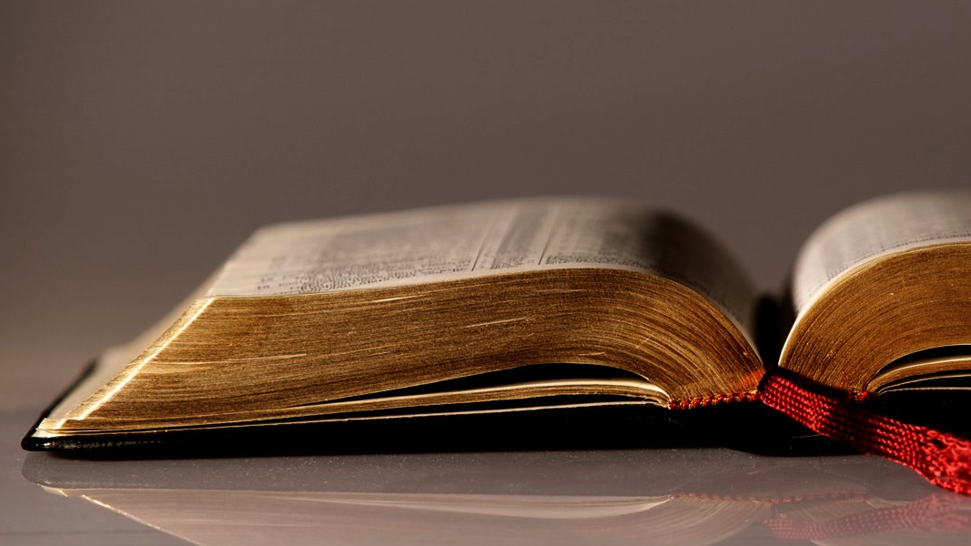
Welcome to
Our Sunday School
We’ll start at 9:07
visit OurSundaySchool.com for more about our class

Slide 2
Today’s class
Overview of the green book
History of Philippi
History of the Philippian church
Reading Philippians
Cursory look at themes

Slide 3
Today’s class
Overview of the green book
History of Philippi
History of the Philippian church
Reading Philippians
Cursory look at themes

Slide 4
Today’s class
Overview of the green book
History of Philippi
History of the Philippian church
Reading Philippians
Cursory look at themes

Slide 5
Today’s class
Overview of the green book
History of Philippi
History of the Philippian church
Reading Philippians
Cursory look at themes

Slide 6
Today’s class
Overview of the green book
History of Philippi
History of the Philippian church
Reading Philippians
Cursory look at themes

Slide 7
Today’s class
Overview of the green book
History of Philippi
History of the Philippian church
Reading Philippians
Cursory look at themes

Slide 8
Closing question: motif or leitmotif?
motif: a recurring theme
leitmotif: a recurring theme associated with a particular person, idea, or situation

Slide 9
Prayer Time
Write down your prayer requests (on the Weekly Update or in the comments)
Lean in, engage, and pray for someone not with you
Go worship

